Slide 1
Study Group
Oracle Certified Associate

Slide 2
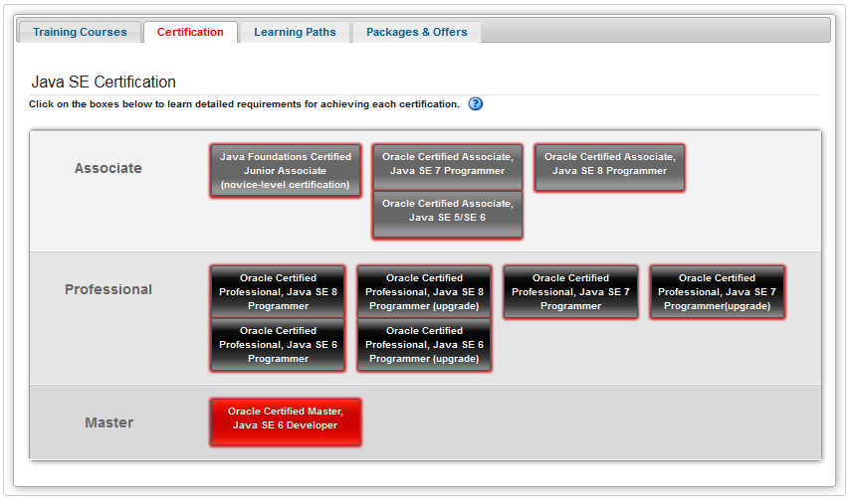
Ce inseamna certificarea si la ce ajuta?
Study Group – Oracle Certified Associate – CE?

Slide 3
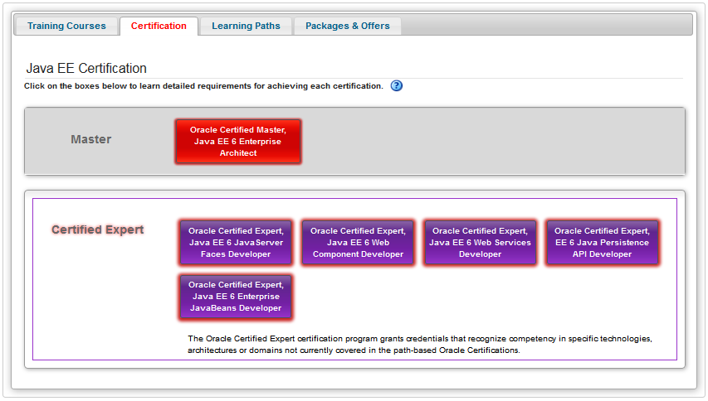
Ce inseamna certificarea si la ce ajuta?
Study Group – Oracle Certified Associate – CE?

Slide 4
Scopul pentru care se participa?
Study Group – Oracle Certified Associate – DE CE?
Țintă – promovarea examenului Java SE 8 Programmer I 1Z0-808
Este primul pas spre obținerea unui certificat de Master / Certified expert
Consolidarea unor informații existente
...
Footnotes and list of references (Arial, 8pt, regular, black)
Position is fix at the buttom and left align

Slide 5
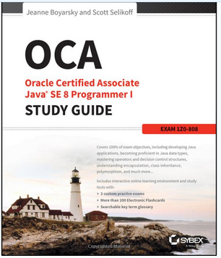
Material Bibliografic
Study Group – Oracle Certified Associate – CU CE?
Material parcurs in timpul celor 7 saptamani de studiu
Footnotes and list of references (Arial, 8pt, regular, black)
Position is fix at the buttom and left align

Slide 6




Material Bibliografic Optional
Study Group – Oracle Certified Associate – CU CE?
Thinking in java (4th Edition) – Bruce Eckel
Head First Java, 2nd Edition – Kathy Sierra, Bert Bates
Effective Java – Joshua Bloch

Slide 7
Ce o sa facem noi
Study Group – Oracle Certified Associate – CUM?
Discutam materialul citit
Comparăm răspunsurile la grile

Slide 8
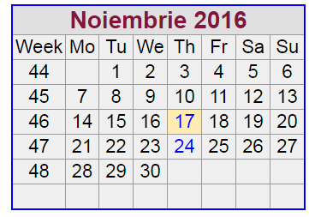
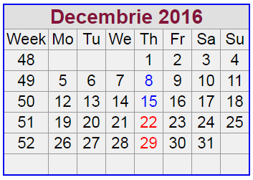
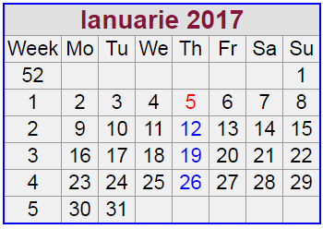
Perioada
Study Group – Oracle Certified Associate – CÂND?
9 Ședințe
6 Capitole
2 Ședințe pentru test sau dicuții
Ora 16?

Slide 9
msg systems ag
Robert-Buerkle-Str. 1, 85737 Ismaning/Munich
Germany
Phone: +49 89 96101-0
Fax: +49 89 96101-1113
info@msg-systems.com
www.msg-systems.com

Slide 10
Name Surname
Function
+49 (0) 175 / 23456789
name.surname@msg-systems.com
msg systems ag
Robert-Buerkle-Str. 1, 85737 Ismaning
Germany
www.msg-systems.com
Name Surname
Function
+49 (0) 175 / 23456789
name.surname@msg-systems.com

